Slide 1
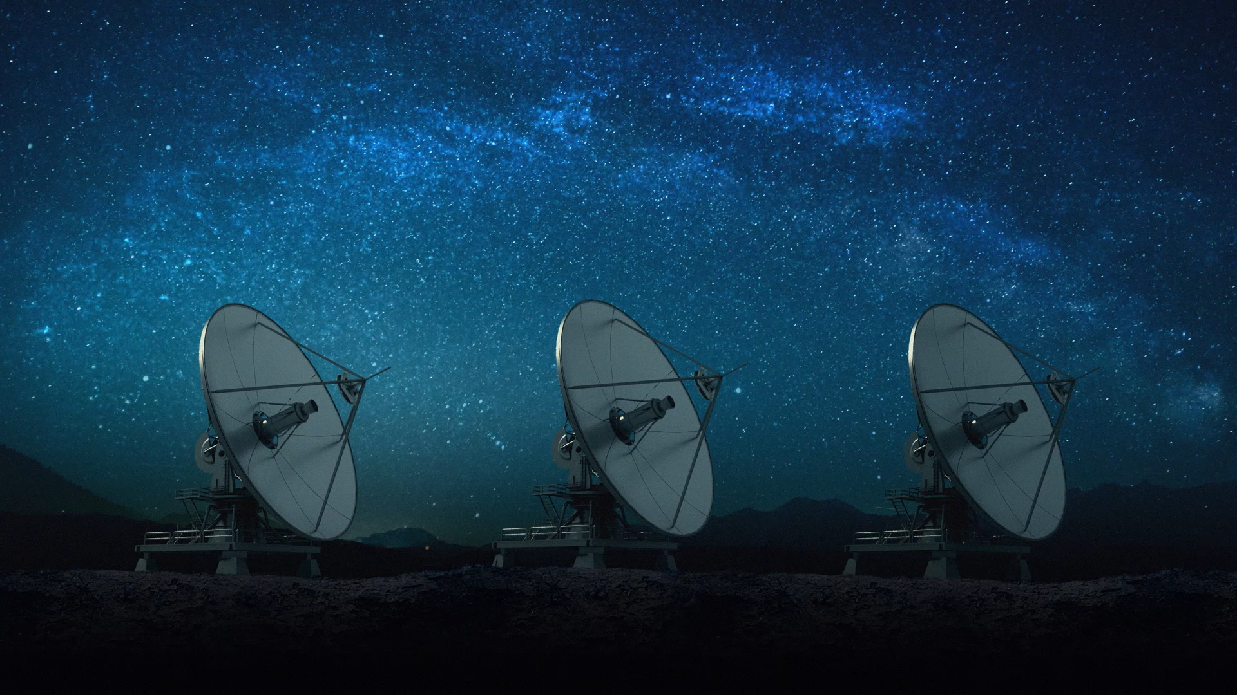
NASA Space Mission AI Project
Conceptual Design Track
By: Mohammad Sufyaan
Course: ITAI 2372

Slide 2

Problem Statement
Space missions require precise, adaptive planning.
Traditional tools lack flexibility and real-time response.
AI can optimize safety, efficiency, and mission success.

Slide 3

AI in Space Missions
Handles uncertainties like hazards and rerouting.
Improves trajectory decisions under constraints.
Learns from simulations and real mission data.

Slide 4
Project Overview
Designing an AI-powered mission planner.
Optimizes fuel, crew safety, and time.
Simulates space conditions and predicts hazards.

Slide 5
System Architecture
Inputs: Destination, fuel, constraints.
AI Engine: RL agent, hazard prediction.
Outputs: Mission path, timeline, resources.

Slide 6
AI Techniques Used
Reinforcement Learning for trajectory learning.
Supervised Learning for hazard prediction.
Simulation-based environment modeling.

Slide 7
Simulation Scenarios
Earth to Mars or Moon missions.
Emergency reroutes due to hazards.
Resource-optimized test missions.

Slide 8
Testing & Evaluation
Efficiency: fuel use, time, hazard avoidance.
Simulated missions with stress conditions.
Compare AI paths with NASA missions.

Slide 9
Benefits to NASA
Smarter mission decisions.
Improved risk response.
Reduced planning time and errors.

Slide 10
Conclusion & Future Work
AI mission planners improve safety and success.
Next: expand to real-time onboard decision-making.
Explore broader mission types (asteroids, probes).

